Slide 1

PerceptNet: Learning perceptual similarity of haptic textures in presence of unorderable triplets
Priyadarshini¹ , Siddhartha Chaudhuri^{1,2}, and Subhasis Chaudhuri¹
¹IIT Bombay, ²Adobe Research
IEEE WHC 2019
July 10, 2019

Slide 2

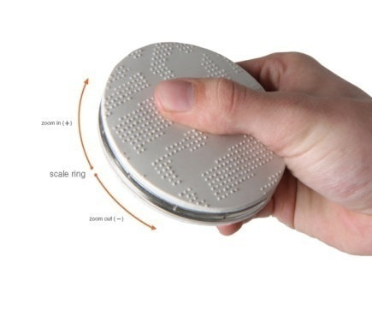

Goal – To model perceptual dissimilarity between haptics textures
Important aspects
Incorporate human notion of perceptual dissimilarity
Model wide range of perceptual dissimilarity (highly similar to highly dissimilar)
Embed new signals without retraining the model from scratch
https://phys.org/
Notes:
For eg in image compression goal is for compressed image to be indistinguishable from original image even if pixel values are different.

Slide 3
Key Idea 1
Aluminum
Copper
Aluminum
Copper
Grass
Grass
Semantic Embedding
Perceptual Embedding
Objective is to preserve human perceived relative dissimilarity between clusters

Slide 4
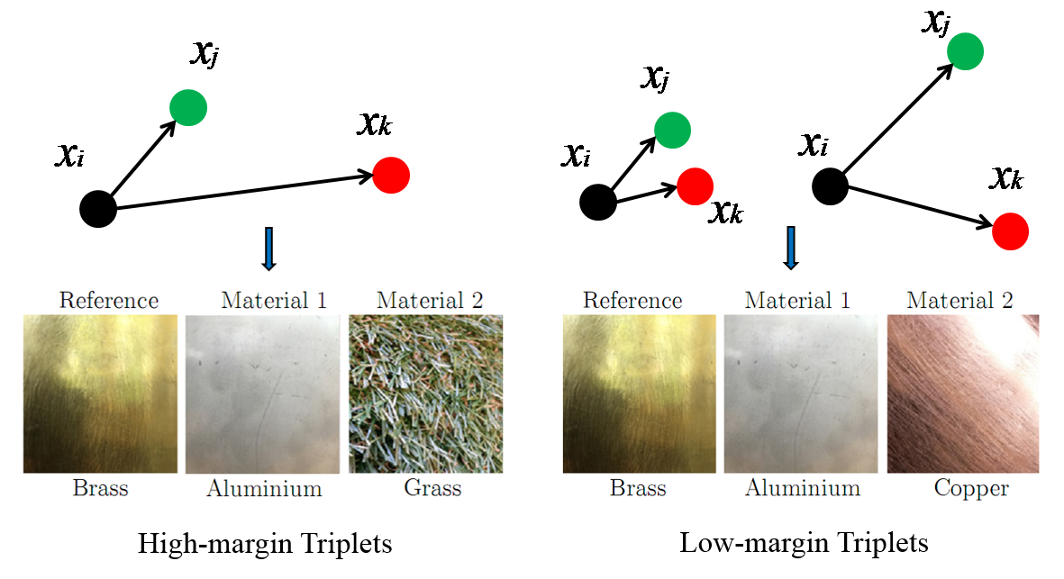
Key Idea 2
Low-margin triplets are informative in modeling perceptual dissimilarity in entirety
Notes:
If at all in literature perceptual space is learned from relative ordering, only high margin triplets are considered for training the model

Slide 5
Key Idea 3
Perceptual Embedding Methods
Parametric
Non-Parametric
Allows out-of-sample extension [1, 2,3]
Can incorporate low-margin triplets
Can be formulated in terms of relative as well as quantitative similarity [1, 2, 3]
Does not work on new sample [4, 5, 6]
Does not incorporate low-margin triplets [4, 5, 6 ]
Typically formulated in terms of quantitative dissimilarity [4, 5]
1-Richard et al. CVPR2018, 2- Brian et al. JMLR2011, 3- Rui et al. ICASSP 2017, 4-Enriqz et al.ICMI 2006,
5-Sameer et al. AISTATS 2007, 6-Lauren et al. IWMLSP 2012
Notes:
Referred relevant literature in vision, audio and haptic domain -> can be categorized into two

Slide 6
Perceptual Embedding of Haptic Texture

Slide 7
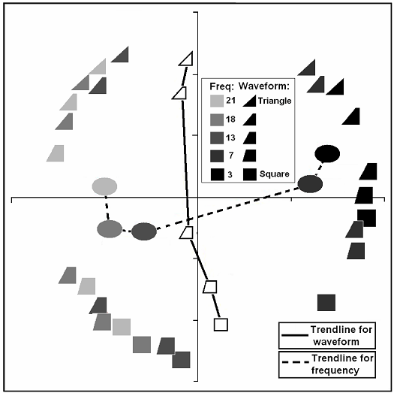
Related work
Goal: To design a set of well distinguishable haptic icons
Input data: 25 haptic stimuli
Method: MDS is used to select 9 most separable stimuli
Limitations:
Requires users dissimilarity rating for all possible signal pairs
Requires numerical estimates of pair-wise distance
Non-parametric approach
Fails to incorporate uncertainty in comparisons
Enriqz et. At ICMI - 2006
Notes:
Not scalable to large dataset, cannot embed new signals,

Slide 8

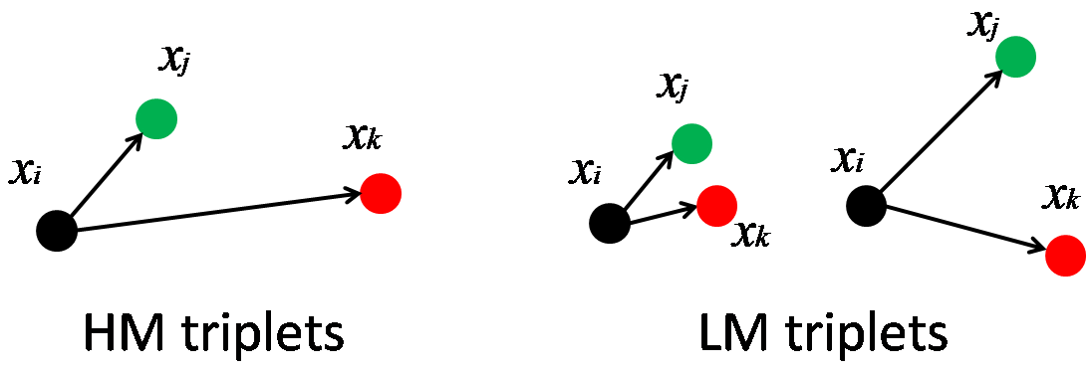
Our Method
Aluminum
Copper
Brick
Wood
Grass
Generalizes to unseen signals
Works even with partial training data
Requires non-numerical relative comparisons of signals
Accommodates both types of triplets
Advantages

Slide 9
Our Method
To learn an embedding function such that the Euclidean distance satisfies:
We use a deep neural network(DNN) to learn
: Hyper-parameter

Slide 10
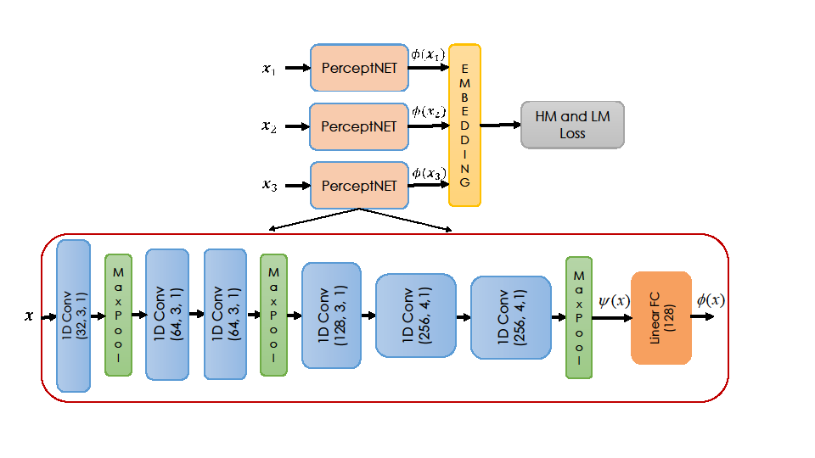
Our Method

Slide 11
Our Method
Based on the type of triplet, distance margin is penalized by following loss function
Network is trained iteratively using standard backpropagation technique

Slide 12
Experiments
Input – CQFB features of acceleration signals recorded from 108
classes (metal, grass, etc) with 10 samples each and GT perceptual distance of each pair of classes
Ground-truth
- Fraction of subjects (out of 30) could distinguish
between corresponding classes
- 10% of the maximum margin over all possible triplets of signal
Triplets
generation
Stresse et al. TOH 2017
Notes:
For all the experiments I have generated equal number of HM and LM triplets, 20k training and 20k testing

Slide 13
Experiments
Evaluation
Triplet generalization accuracy (TGA) - Fraction of satisfied triplet constraints in a test set
is estimated by minimizing where
- fraction of high-margin correctly classified training triplets
- fraction of low-margin correctly classified training triplets

Slide 14
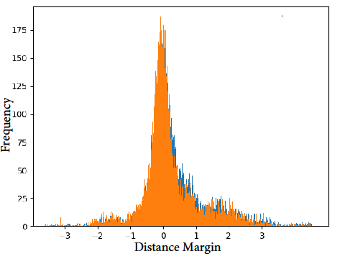
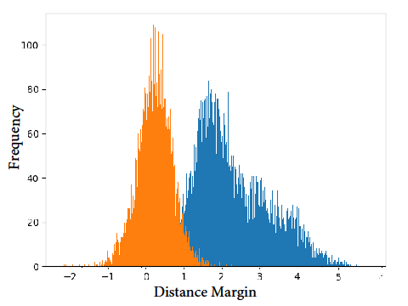
Experimental Results
Histogram of test triplet margins
Distribution of learned high-margin (blue) and low-margin (orange) triplet in Mahalanobis space (left) and in PerceptNet space (right)

Slide 15
Experimental Results
Three variants of experimental protocol-
Held-Out Triplets – 50% of triplets are held-out for testing , however the samples and classes are common for training and testing
Held-Out Samples- 20% samples from each class are held-out for testing
Held-Out Classes- All samples from 20% class are held-out for testing

Slide 16
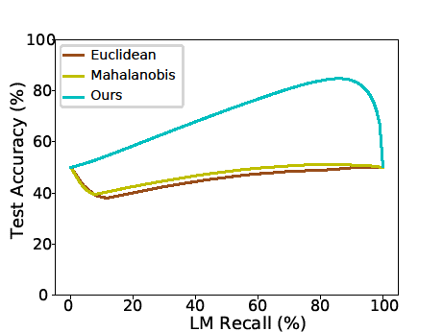
(1) Experimental Results (Held-Out Triplets)
Triplet Generalization Accuracy (TGA) of different metric at optimal threshold (left) and full range of thresholds(right)

Slide 17
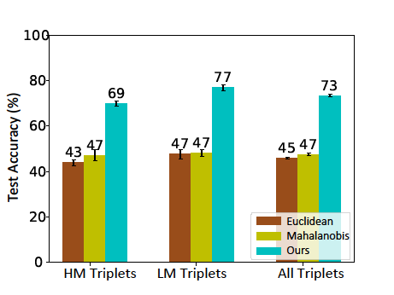
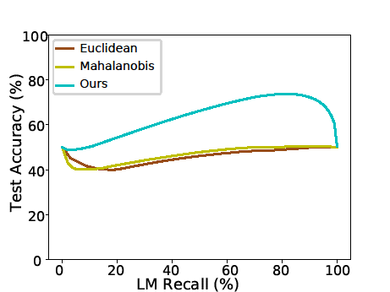
(2) Experimental Results (Held-Out Samples)
The accuracies of PerceptNet reduces in this harder case (73%), but PerceptNet is still distinctly better

Slide 18
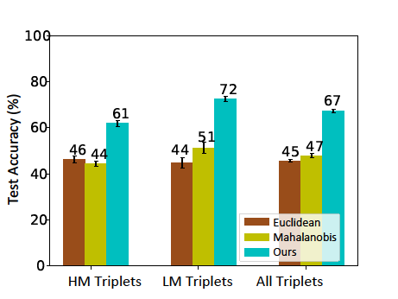
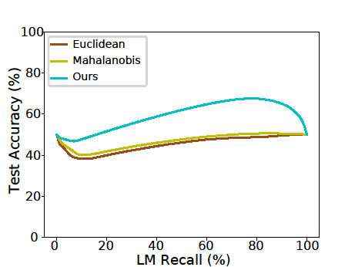
(3) Experimental Results (Held-Out Classes)
The accuracies of PerceptNet further drops to (67%), but PerceptNet is still generalizes much better.
18

Slide 19
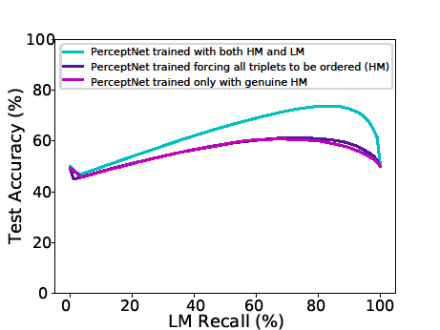
Experimental Results:
Importance of low margin triplets
Triplets
generation

Slide 20
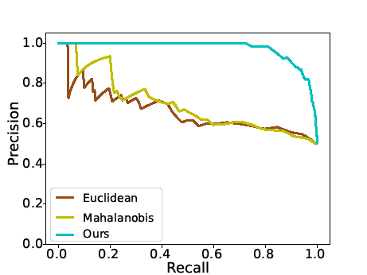
Experimental Results
Pairwise distinguishability of PerceptNet
Ground-truth generation - A pair is considered distinguishable if >50% subjects can distinguish
AUC
Perceptnet | 0.97
Mahalanobis | 0.69
Euclidean | 0.66
Precision-recall plot for classifying distinguishable and indistinguishable pairs of signals

Slide 21
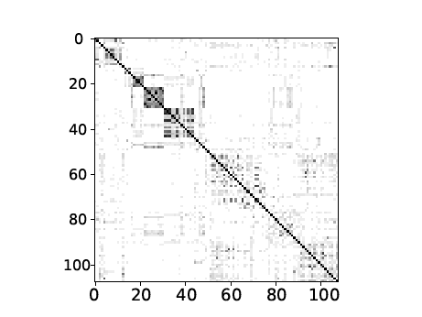
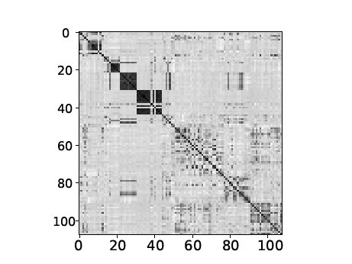
Experimental Results
Confusion matrix - White indicates low and black high similarity
Ground-truth
Estimated
PerceptNet is trained only with relative similarity, hence relative ordering is preserved not the numerical ground-truth confusion values

Slide 22
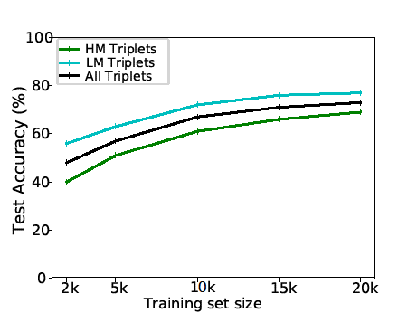
Experimental Results
Dependence of training set size
Accuracy increases proportionally with the size of the training set, but with decreasing benefits for larger sizes

Slide 23
Perceptual Embedding of Olfactory Signals

Slide 24
Experiments
Input: Chemical features (X) and perceptual descriptor of 268 compounds (Octanol, Benzaldehyde, and Hexenel.)
Chemical features : hydrogen bond, molecular weight and heavy atom count etc
Perceptual descriptors: Human subjects rating against odor descriptors such as pungent, fruit, mint and smoke
- obtained using cosine similarity
Triplets generation:
24
Kush et al. DSP 2016

Slide 25
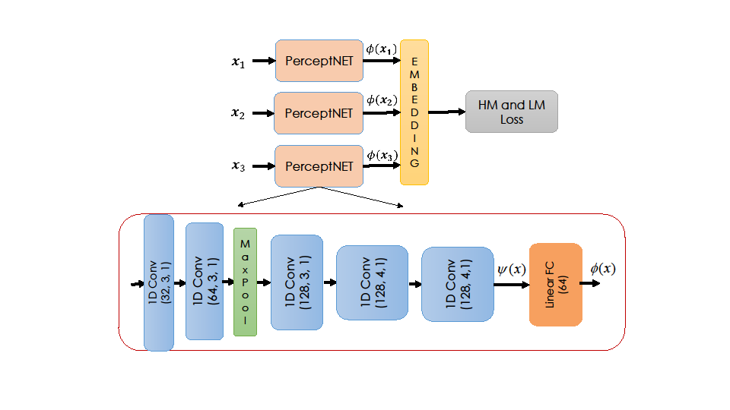
Network Architecture

Slide 26
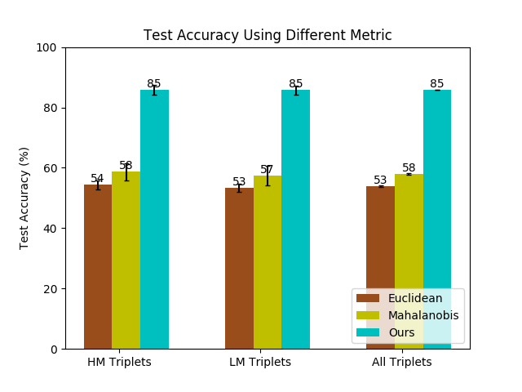
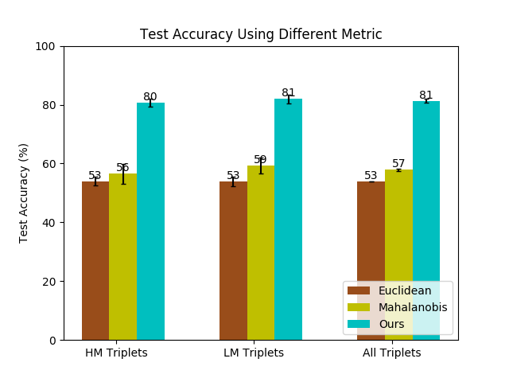
Experimental Results (Olfactory Data)
Held-Out Triplets
Held-Out Classes
Unlike haptic dataset, in this case, model generalizes quite well even for compounds never seen before
26

Slide 27
Perceptual Embedding of Image Data

Slide 28
Experiments
Input: 100 images and ground truth perceptual similarity matrix generated from crowd sourced perceptual grouping judgments
Ground-truth:
- Fraction of subjects (out of 100) could distinguish
between corresponding classes
- 10% of the maximum margin over all possible triplets of signal
Triplets generation:
28
28
David et al. CHI2015

Slide 29
Network Architecture

Slide 30
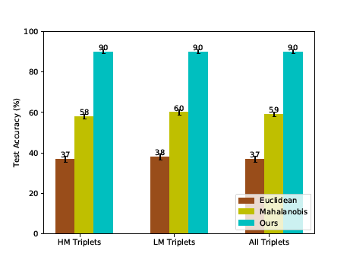
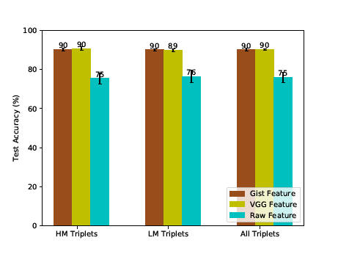
Experimental Results
Performance comparison of different metric using gist feature
Performance of our model using different features

Slide 31
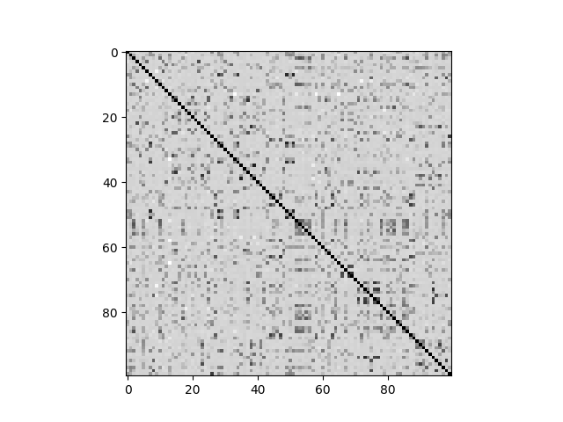
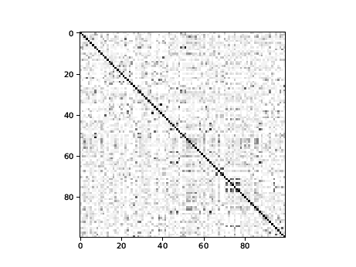
Experimental Results
Pairwise distinguishability
Ground-truth
Estimated
Confusion matrix- White indicates low and black high similarity

Slide 32
Future Work
Dealing with limited training data – Active learning
Generating new sample from perceptual space by inverse mapping
Better acquisition of data- finding trade-off between human effort and accuracy of model.

